Slide 1





GIVING OUR LIVES TO THE LORD

Slide 2




Mga rason bakit kailangan natin ipagkatiwala ang buhay natin sa kaniya?

Slide 3

For we don't live for ourselves 0r die for ourselves. If we live, it's to honor the LORD. And if we die, it's honor the LORD. So whether we live or die, we belong to the LORD.
ROMANS 14: 7-9

Slide 4




WE WILL EXPERIENCE:
1 | 2 | 3 | 4 | 5
TO ENJOY LIFE | TO BE HEALED AND RESTORED | TO BE BLESSED AND SUCCESSFUL | TO BE A BLESSING | TO ETERNALLY SECURED

Slide 5

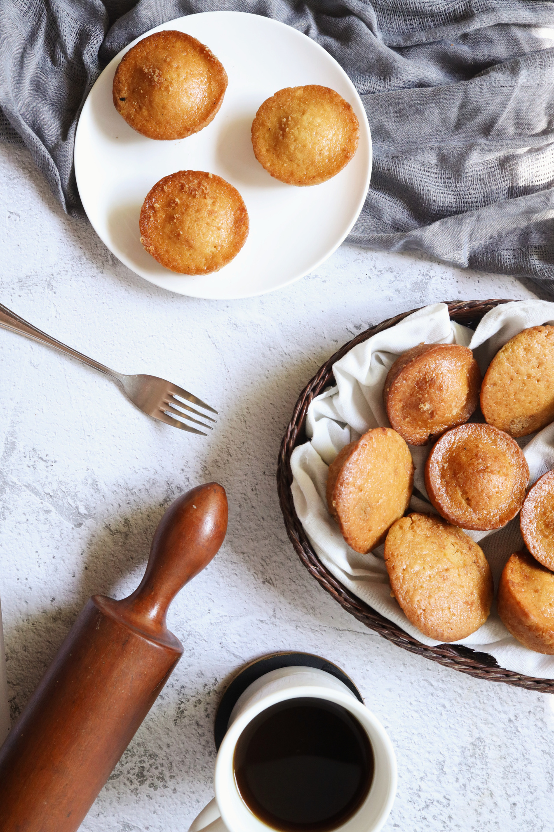


For the kingdom of God is not a matter of what we eat or drink, but of living a life of goodness and peace and joy in the HOLY SPIRIT. If you serve Christ with this attitude, you will please GOD, and others will approve of you too. So then, let us aim for harmony in the CHurch and try to build ech other up.
ROMANS 14:17-19

Slide 6



Thank you for listening!
SHALOM !

